Slide 1
NoteSpace
Group 2
Aditi Page Kartik Rode Saheel Sawant Swarada Sathe

Slide 2
Motivation
To shorten the iterative process of note-making while maintaining efficiency
To incorporate auto-reflection of text
To extend the concept of electronic note making
Why is it significant?
To reduce the dependency on different applications by providing a concurrent view in the same application

Slide 3
Proposed Approach
Project Type: Research Oriented Design (ROD)
Seed Idea: Note-making using direct manipulation
Why is this seed idea interesting? - It addresses a very common problem of efficiency in note-making with enhanced retentivity and focus using a new perspective
Comparison model: Compares traditional method (PDF-MS Word) with our system (NoteSpace)

Slide 4
Related Work

Slide 5
Paper 01
Paper 02
Paper: Direct Manipulation Interfaces
Authors: Donald A. Norman, Hutchins, James D. Hollan
Theme: Direct Manipulation
Paper: The Reading Desk: Applying Physical Interactions to Digital Documents
Authors: Jennifer Pearson, George Buchanan, Harold Thimbleby
Theme: Note-taking

Slide 6
Paper 01
Paper 02
Physical actions or labelled button presses instead of complex syntax.
Quick learning for novice users.
Immediate reflection of actions else users they can change their direction.
System is comprehensible
Actions are very easily reversible.
Design and implementation of a system that mimics properties of paper and surpasses them by incorporating digital techniques.
Advantages of ‘Screen over Paper’ and ‘Paper over Screen’ were discussed
Scope for system: Space, separate tools with different actions, menu navigation
Features of the new system: Virtual desk & Unified post-it tool

Slide 7
System Design - Design Process
Product Research & Ideation: Research done on existing related systems to understand their limitations and benefits. The novel feature that we decided to work on was concurrently making notes in the same application
Design: Wireframes and High-fidelity prototype
Testing and Validation: Between-subjects study design
Notes:
Explain the novel feature by using the before-mentioned seed idea

Slide 8
System Design: Control System
Combination of two existing software applications -
Microsoft word for note making
Adobe Acrobat Reader DC for pdf viewing and highlighting
Notes:
Acrobat was chosen since its the popular choice in Windows. Preview in Mac

Slide 9
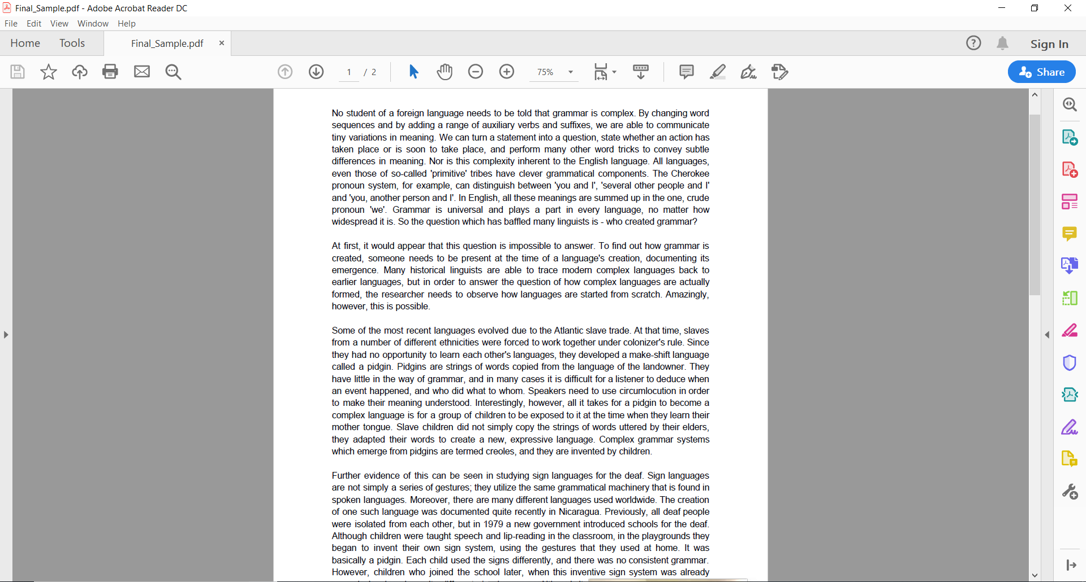
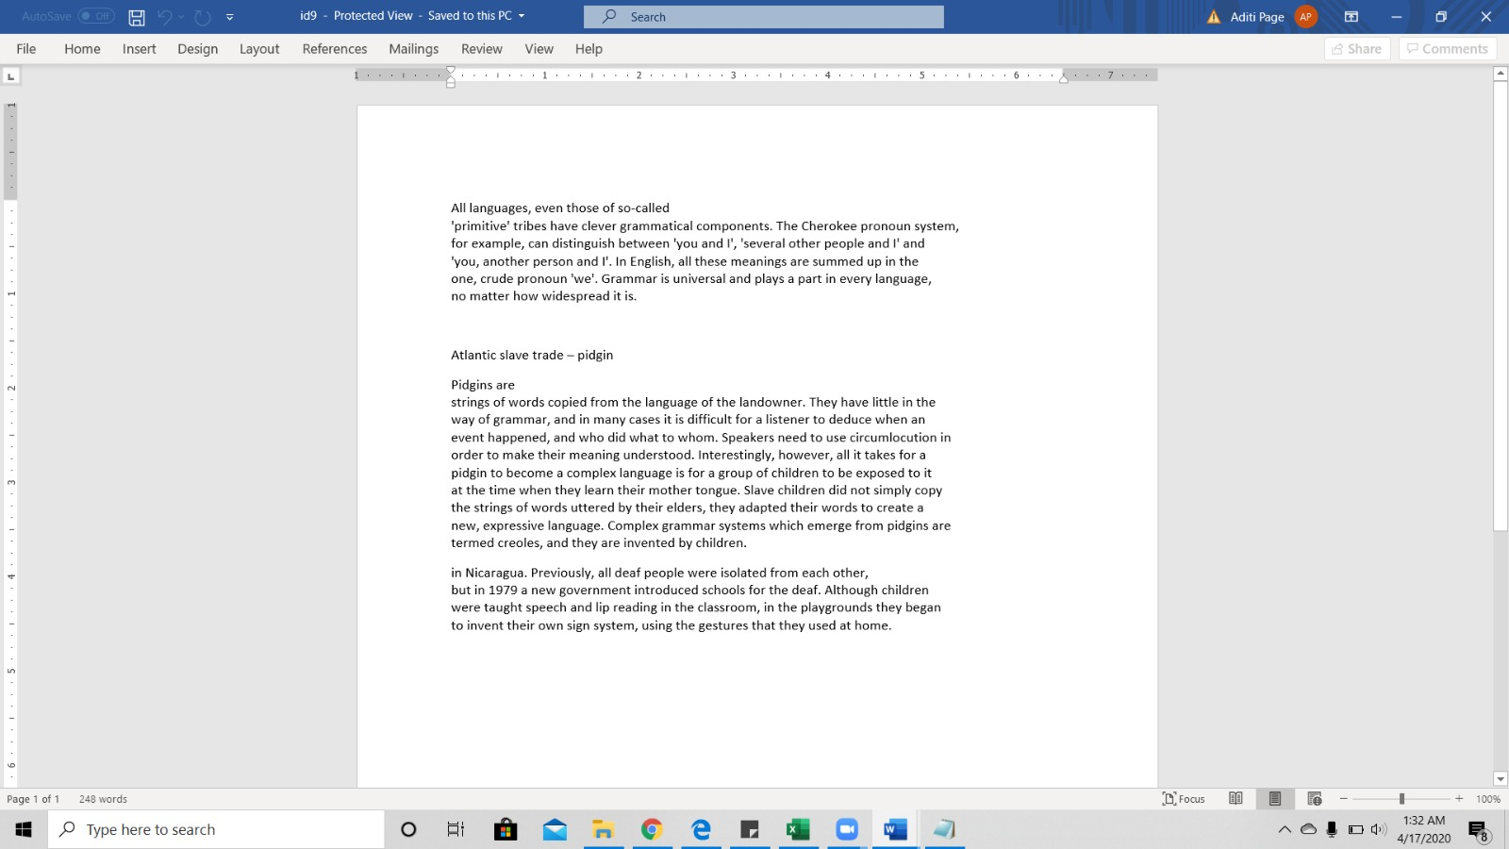
Acrobat Reader DC
Microsoft Word

Slide 10
System Design: Final System
GUI-based desktop application which would allow the user to choose a file from his/her filesystem
Technology stack used -
HTML/CSS
Javascript
NodeJS
Electron Framework
Python

Slide 11
System Design: Final System
Concurrent view of two sections
One contains imported document and
The other contains the workspace to make notes
Auto-copying of selected text that reflects concurrently in workspace
Use of multiple colors to highlight text
Deletion of text in the notes section using double-click
Exporting notes to PDF when user wants to save notes to their system

Slide 12
System Design: Final System

Slide 13
Study Methodology
Research-oriented Design: Between - subject study design
Independent variables: Method of note-making wrt. systems
Dependent variables:
Effectiveness:
Time taken to make notes
Number of colors used for highlighting text
Questionnaire
Usability:
Cognitive load on the user (Questionnaire) [Separate highlighting v/s automatic]
Retention capability:
Questionnaire

Slide 14
Participants
Number of participants: 12
Majors:
Computer Science
Industrial Engineering
Mechanical Engineering
Business Intelligence
Philosophy
7 males, 5 females
Age range: 22-25

Slide 15
Testing Process
Questionnaire to get participant demographics
Explanation of the steps performed during the test
Introduction of the the application to the participant
Participants read the provided document and prepared notes as per their requirement
Retentivity Test based on the topic given in the document
Post-Study Questionnaire to gather participants’ views on the system

Slide 16
Testing Process
Traditional Method Actions: 1) Users will get the PDF document, they will read them 2) Select the important text from the document provided as per the requirement of notes and paste it in the MS word document. 3) Answer the questions from Google Form. Sequence: Participant Details: 02 mins Introduction: 05 mins Reading: 10 mins (max limit) Q/A: 05 mins | NoteSpace Actions: 1) Users will import and read the given document. 2) Highlight important text from the document to make pointwise notes on the right side. 3) Export the notes generated in NoteSpace 4) Answer the questions from Google Form 5) Fill out Post session Questionnaire Sequence: Participant Details: 02 mins Introduction: 05 mins Reading: 10 mins (max limit) Q/A: 05 mins Questionnaire: 02 mins

Slide 17
Test Conditions
Notes:
In both the conditions, upper bound for the time given for reading (10 mins max) and testing (5 mins max)

Slide 18
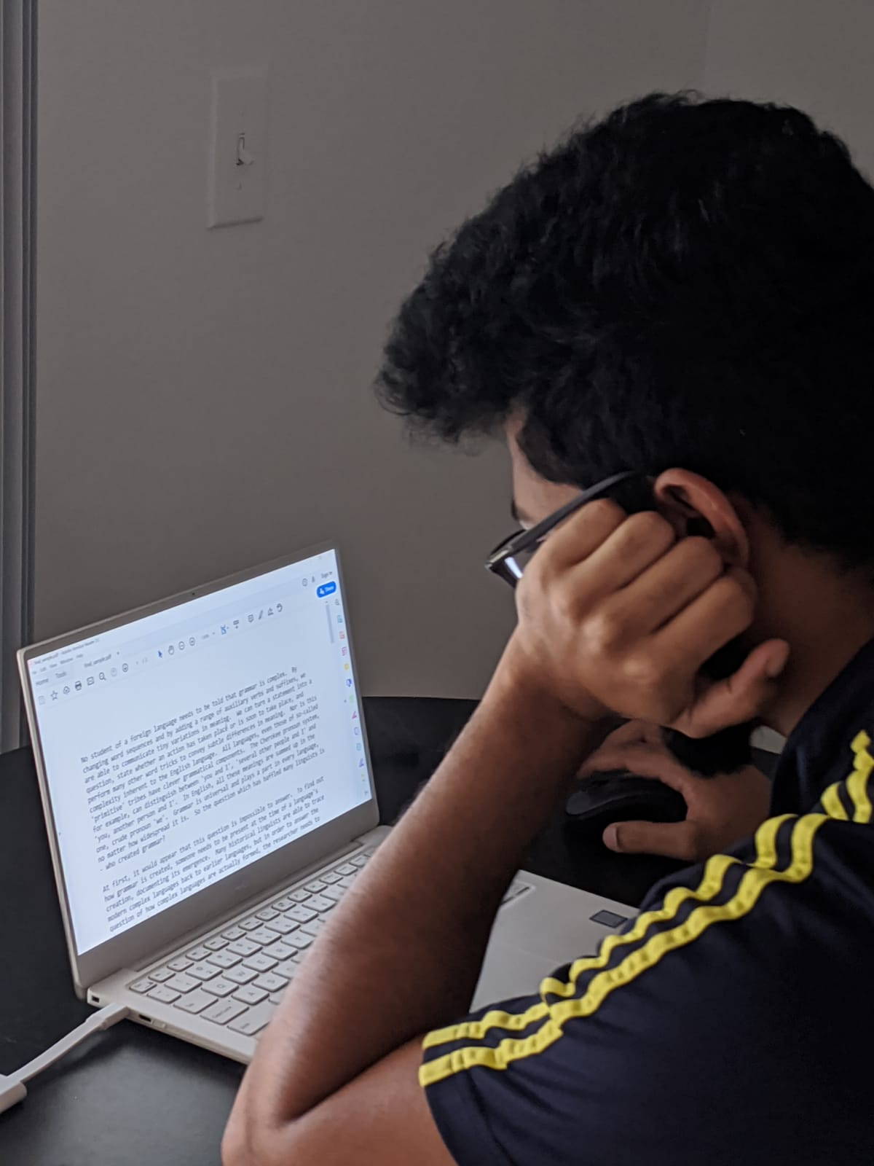
Condition 1
Note making using the traditional method
Adobe Acrobat Reader DC to view document
Microsoft Word to paste selected text

Slide 19
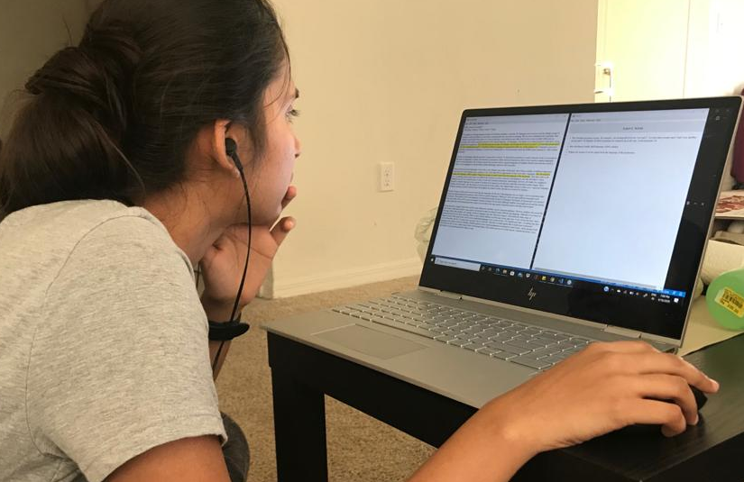
Condition 2
Making notes using NoteSpace (our system)

Slide 20
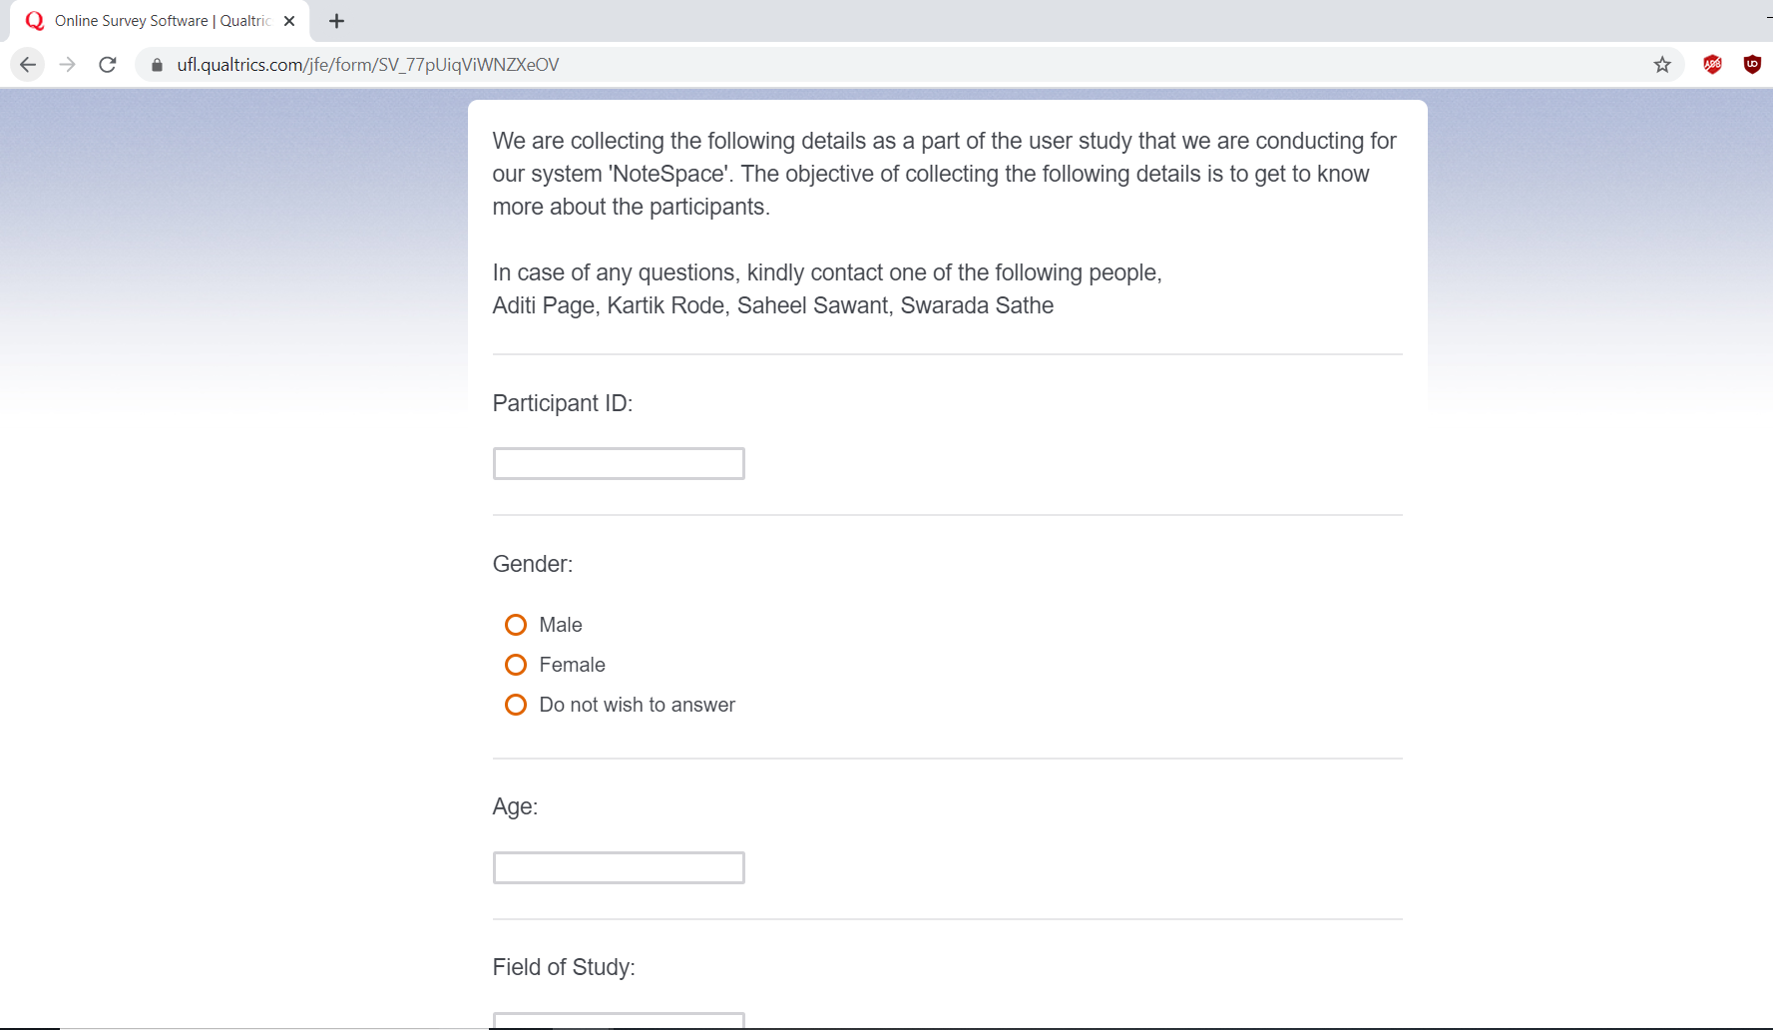
Participant Details

Slide 21
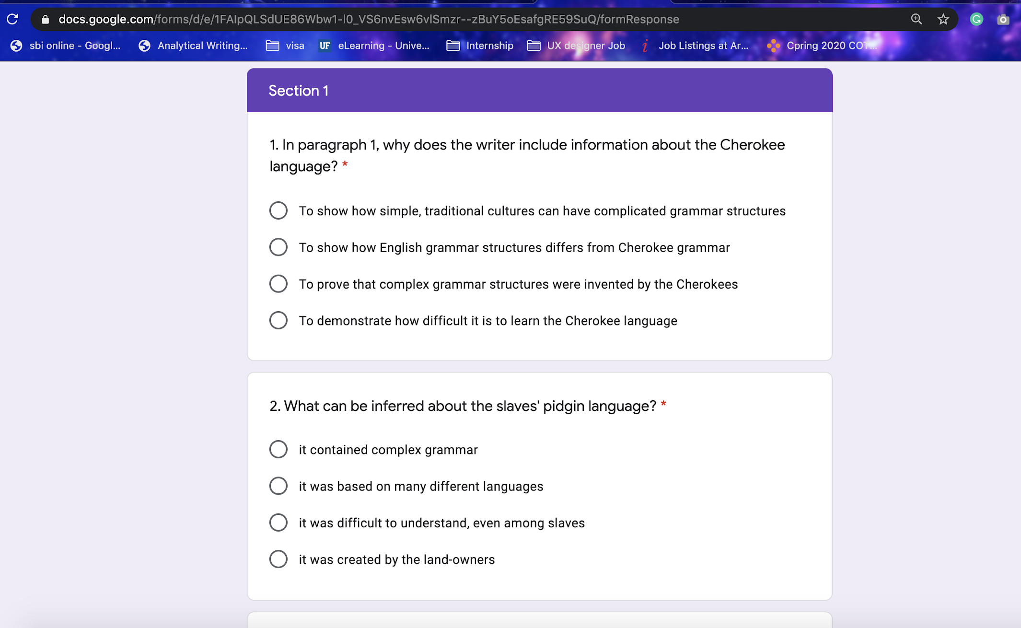
Retentivity Test Questionnaire

Slide 22
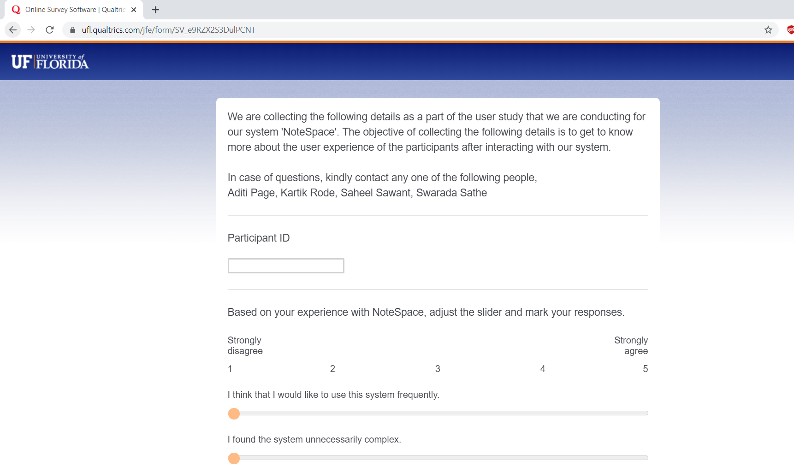
Post Session Questionnaire

Slide 23
Data Collected
Participant details
Age
Field of study
Frequency of use of PDF Reader
Frequency of use of Microsoft word for note making
Method of note making (collated points/paragraph, highlighting)

Slide 24
Data Collected
(contd.)
During the session
Time taken to read the text and make notes
Number of highlighting colors used
Number of points in notes
Time taken to answer the questions

Slide 25
Data Collected
(contd.)
Retentivity Test
Set of 5 questions based on the text piece given for note making
Multiple - choice questions

Slide 26
Data Collected
(contd.)
Post-session Questionnaire
SUS Test
Frustrating points of the system
Unique feature of the system
Suggestion/comments (optional)
Notes:
Post session questionnaire was given to the Condition 2 participants only,

Slide 27
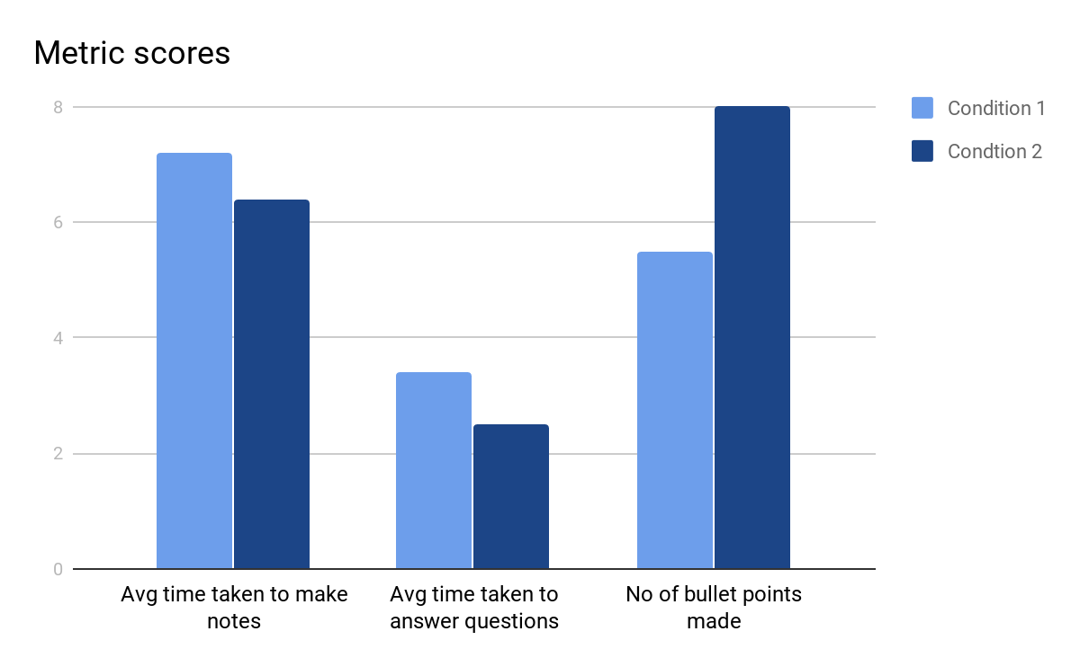
Data Analysis and Results

Slide 28
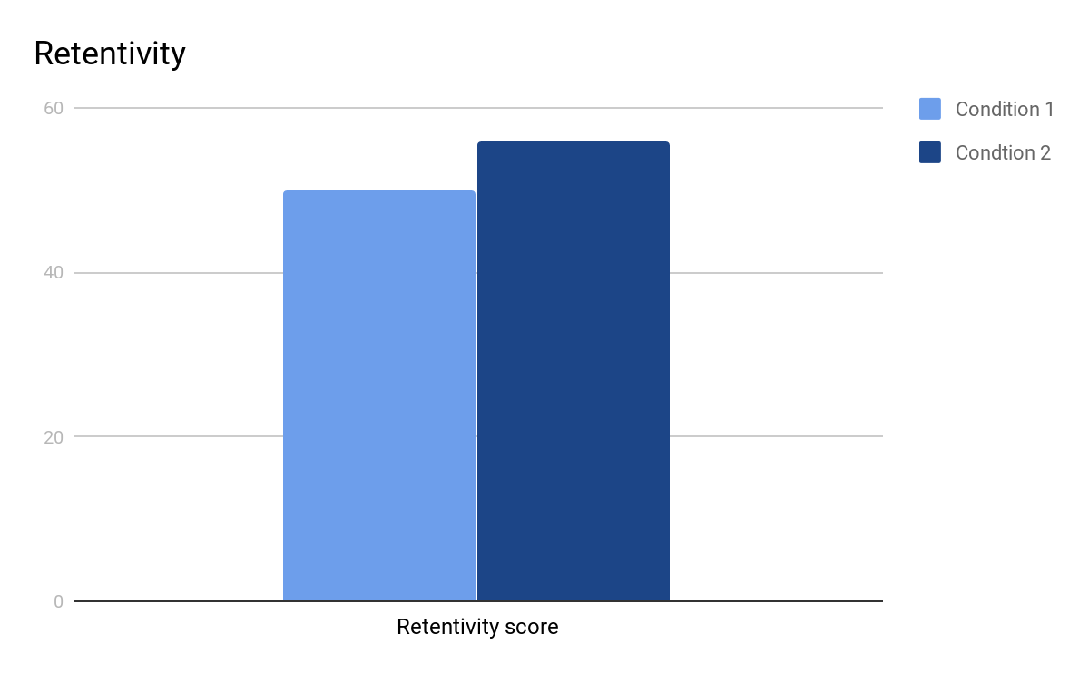
Data Analysis and Results (Contd.)

Slide 29
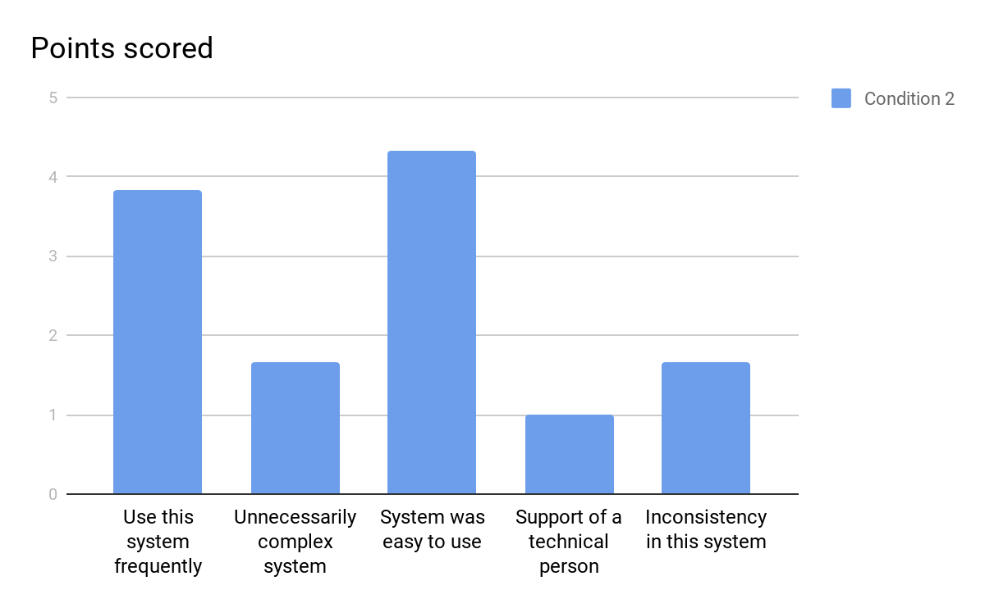
Data Analysis and Results (Contd.)

Slide 30
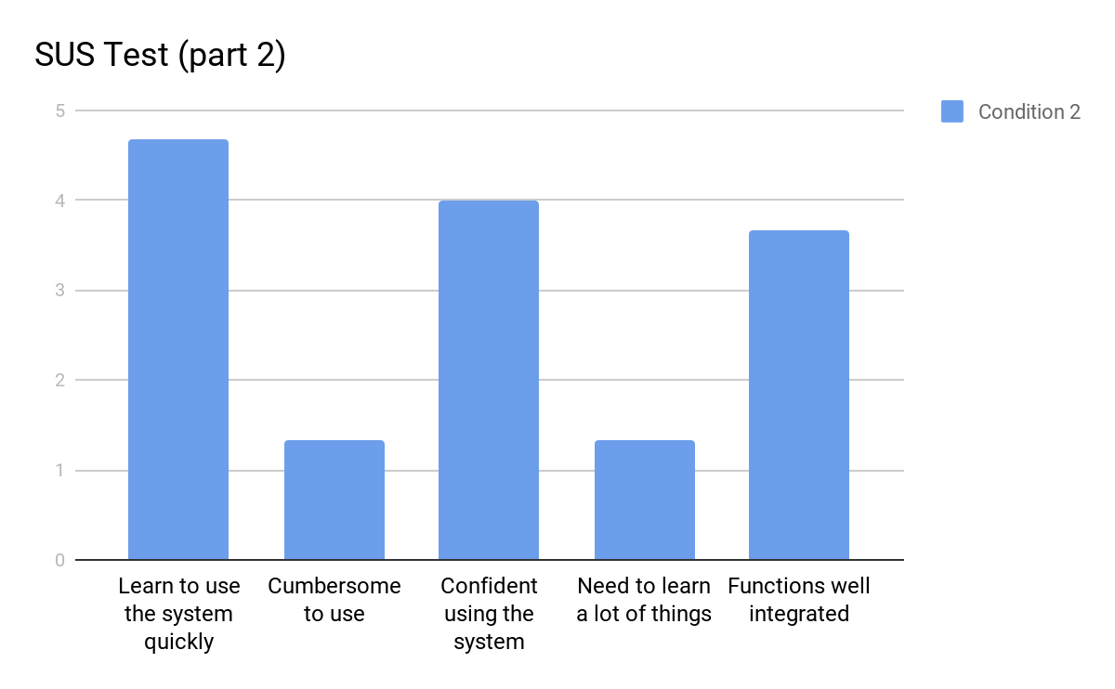
Data Analysis and Results (Contd.)
Data Analysis and Results

Slide 31
Discussion
Lesser time taken to read and prepare notes indicates that our system retains concentration due to concurrent view
Since the user doesn't have to switch between applications, he/she can focus on the text and the results show that their retention is higher when our application is used than as compared to the traditional method
Users tend to make lesser notes when switching between applications
Participants preferred the use of multiple colors for highlighting as indicated by the post-study questionnaire in Condition-2

Slide 32
Limitations and Future Scope
Based on the feedback, we have evaluated the following limitations of our system which we can improve in the future:
Make the notes section editable
Add sub-points in the notes made
Include images and equations in notes

Slide 33
Thank You

Slide 34
References
Ken Hinckley , Shengdong Zhao , Raman Sarin , Patrick Baudisch , Ed Cutrell , Michael Shilman, Desney Tan: InkSeine: In Situ Search for Active Note Taking. CHI 2007, April 28–May 3, 2007, San Jose, California, USA.
Jennifer Pearson, George Buchanan, Harold Thimbleby: The Reading Desk: Applying Physical Interactions to Digital Documents. CHI 2011, May 7–12, 2011, Vancouver, BC, Canada.
Van Wyk, M.van Ryneveld, L. Affordances of mobile devices and note-taking apps to support cognitively demanding note-taking. Educ Inf Technol 23, 1639–1653 (2018).
Kayla Morehead, John Dunlosky, Katherine A. Rawson, Rachael Blasiman, R. Benjamin Hollis (2019):Note-taking habits of 21st Century college students: implications for student learning, memory, and achievement
Ben Shneiderman - Direct Manipulation for Comprehensible, Predictable and Controllable User Interfaces , Proceedings of the 2nd international conference on Intelligent user interfaces January 1997

